Slide 1
IOT Using
Creya Learning & Research Pvt. Ltd.
www.creyalearning.com

Slide 2
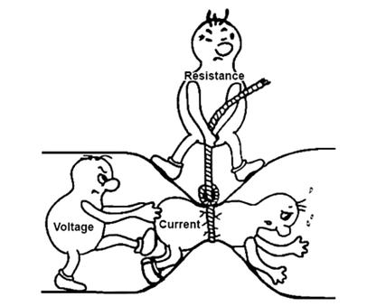
Basic Concepts
Voltage:
Think of voltage as the "pressure" or "potential difference" that pushes electrons through a circuit.
It's measured in volts (V).
A higher voltage means a stronger push, leading to a greater current flow, assuming resistance remains constant.
Current:
Current is the actual flow of electrons through a conductor (like a wire).
It's measured in amperes (amps or A).
A higher current means more electrons are flowing per unit of time.
Resistance:
Resistance is the opposition to the flow of current.
It's measured in ohms (Ω).
Higher resistance means it's harder for the current to flow, requiring a greater voltage to maintain the same current.

Slide 3
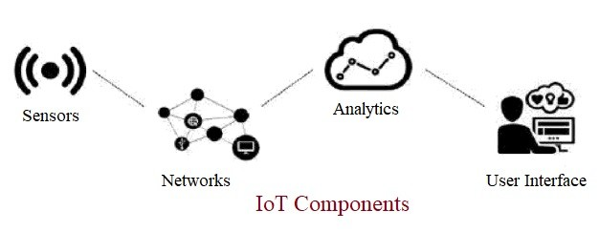
IOT
The Internet of Things (IoT) refers to a network of physical devices, vehicles, appliances, and other objects embedded with sensors, software, and network connectivity, allowing them to collect and share data, enabling communication and automation.

Slide 4
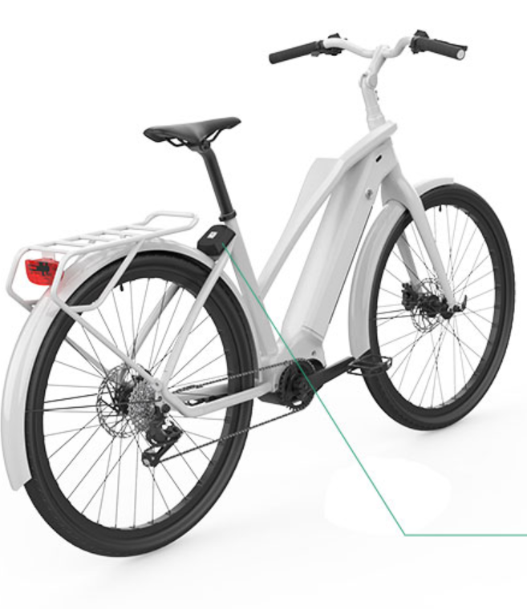
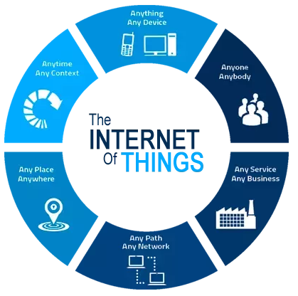
IOT
Example: Smart Bicycle IoT System
Sensors (Pedal): The bicycle has sensors to track speed, distance, and heart rate.
Data Transmission (Wheel): The sensors send this data to your smartphone via Bluetooth.
Cloud Processing (Brake): The data is uploaded to the cloud, where it's analyzed to give you insights like calories burned or average speed.
User Control (Handlebar): You can view this data on a fitness app

Slide 5
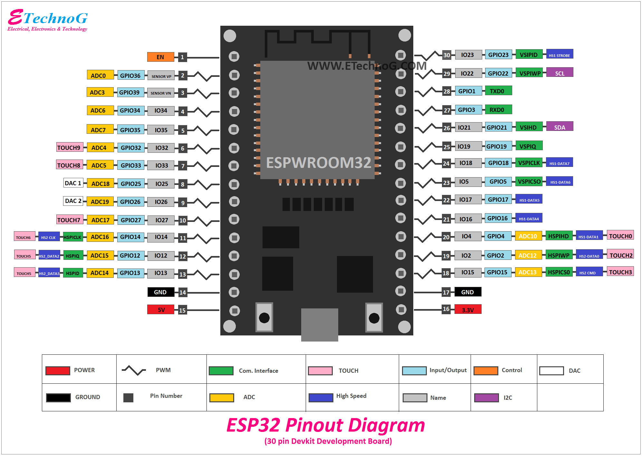
Pin Configuration of ESP-WROOM-32

Slide 6
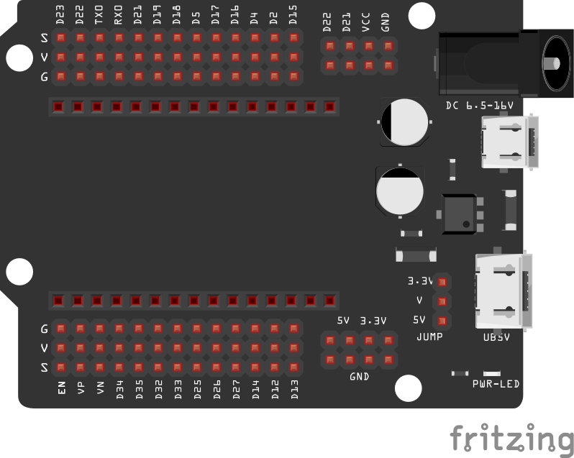
ESP 32 30-Pin extension board
Power INPUT Ports
6-16Volt 9mm jack
5 Volt micro USB
5 Volt C type USB

Slide 7
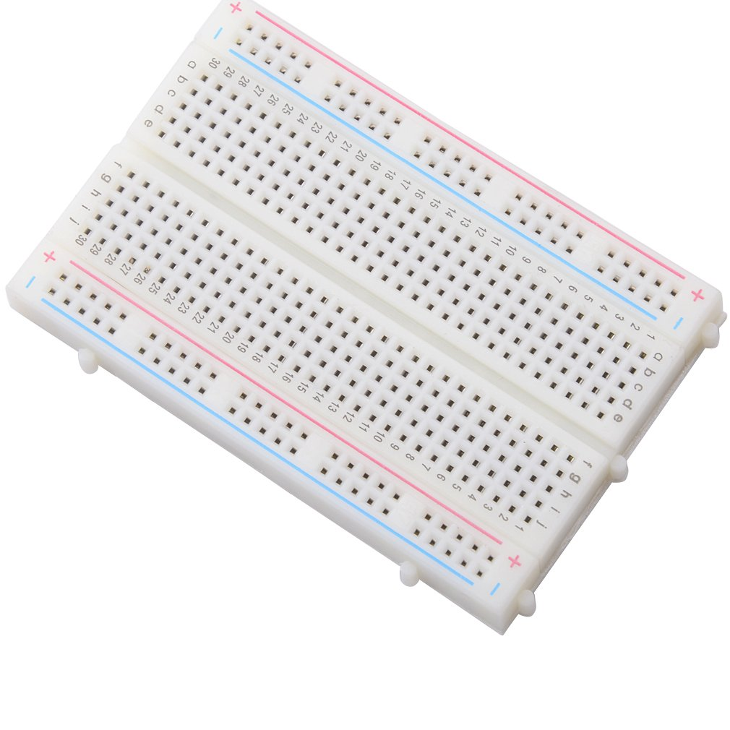

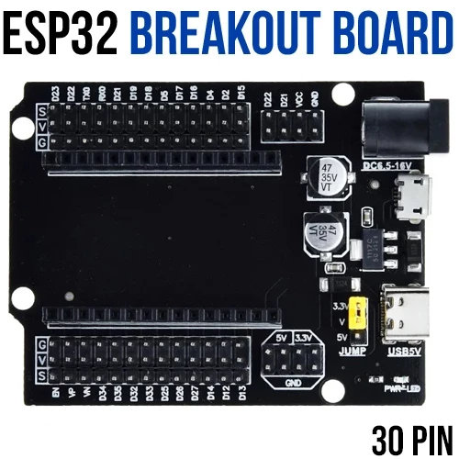
ESP 32 30-Pin extension board
Power OUT Ports
Provision to connect Servomotor directly to the specific signal pin
Individual Power and GND port for each signal pin for connecting sensors, by eliminating breadboard.
Servomotor &Sensor Friendly

Slide 8
ESP 32 30-Pin extension board
Power OUT Ports
GND Rail
5 Volts output rail
5 Volts, 3.3 Volts and GND ports

Slide 9
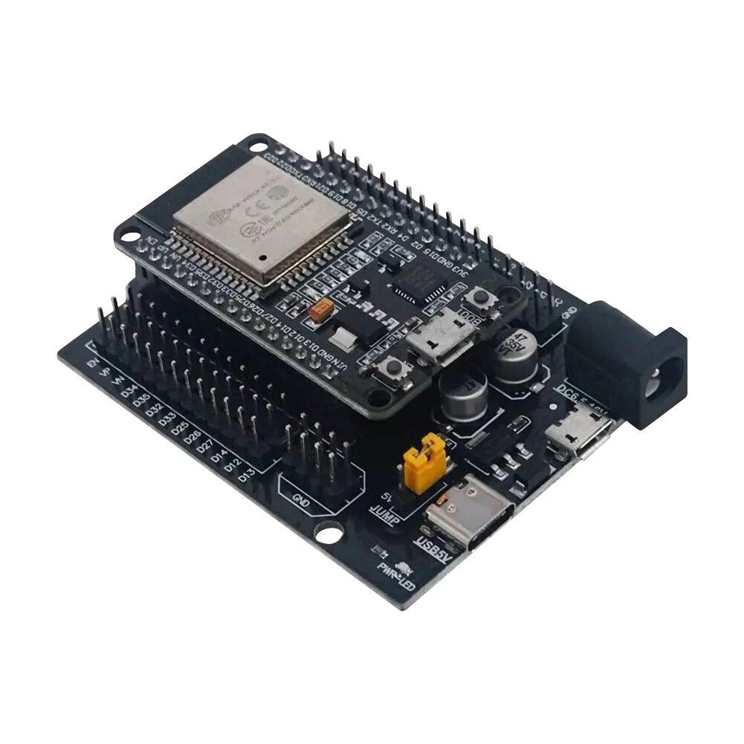
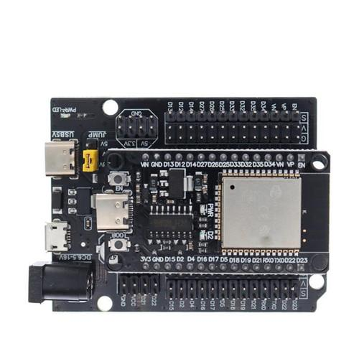
Mounting ESP-32 on the Extension board
Make sure that the EN pin on the Extension board and EN pin on the ESP-32 aligns.
The USB power ports of the Extension board faces the direction of the ESP-32 USB port.

Slide 10
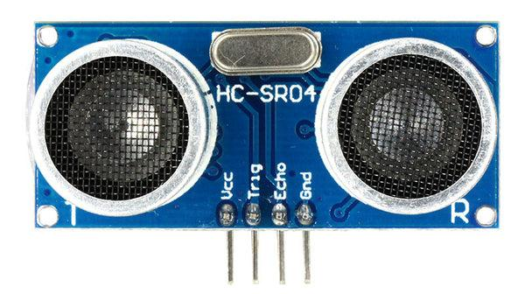
Sensors- Ultrasonic Sensor
An ultrasonic sensor is an electronic device that uses ultrasonic sound waves (above the human audible range) to measure distance or detect objects by emitting and receiving these waves, and then calculating the distance based on the time it takes for the sound to travel to and from the target

Slide 11
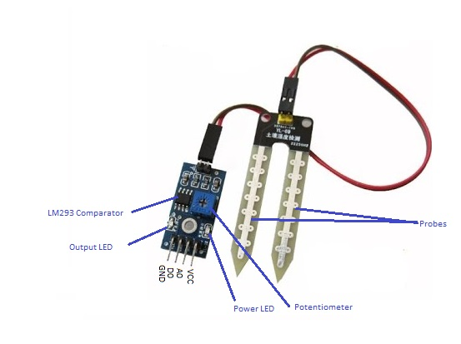
Sensors- Soil Moisture Sensor
A soil moisture sensor is a device that measures the amount of water in the soil, often used to optimize irrigation and plant growth by providing real-time data on soil moisture content

Slide 12
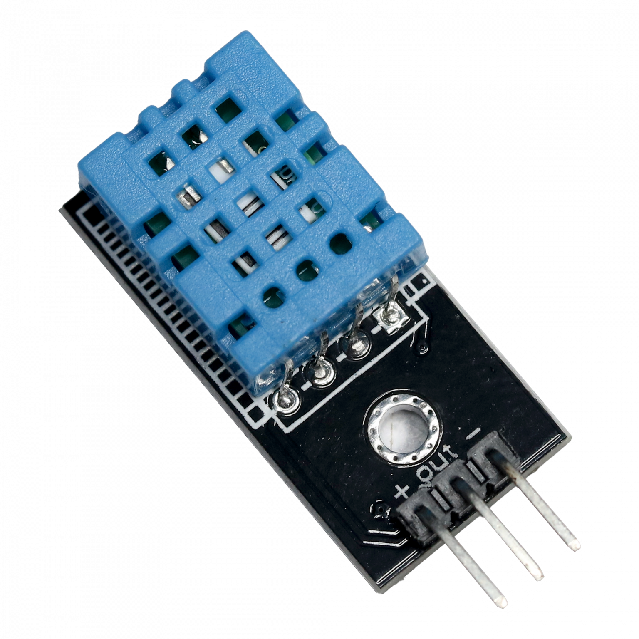
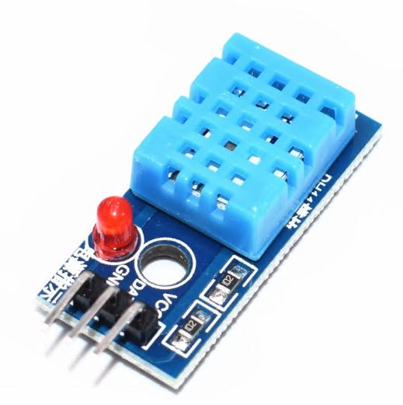
Sensors- DHT11
DHT11 is a low-cost digital sensor for sensing temperature and humidity. This sensor can be easily interfaced with any micro-controller such as Arduino, ESP etc… to measure humidity and temperature instantaneously

Slide 13
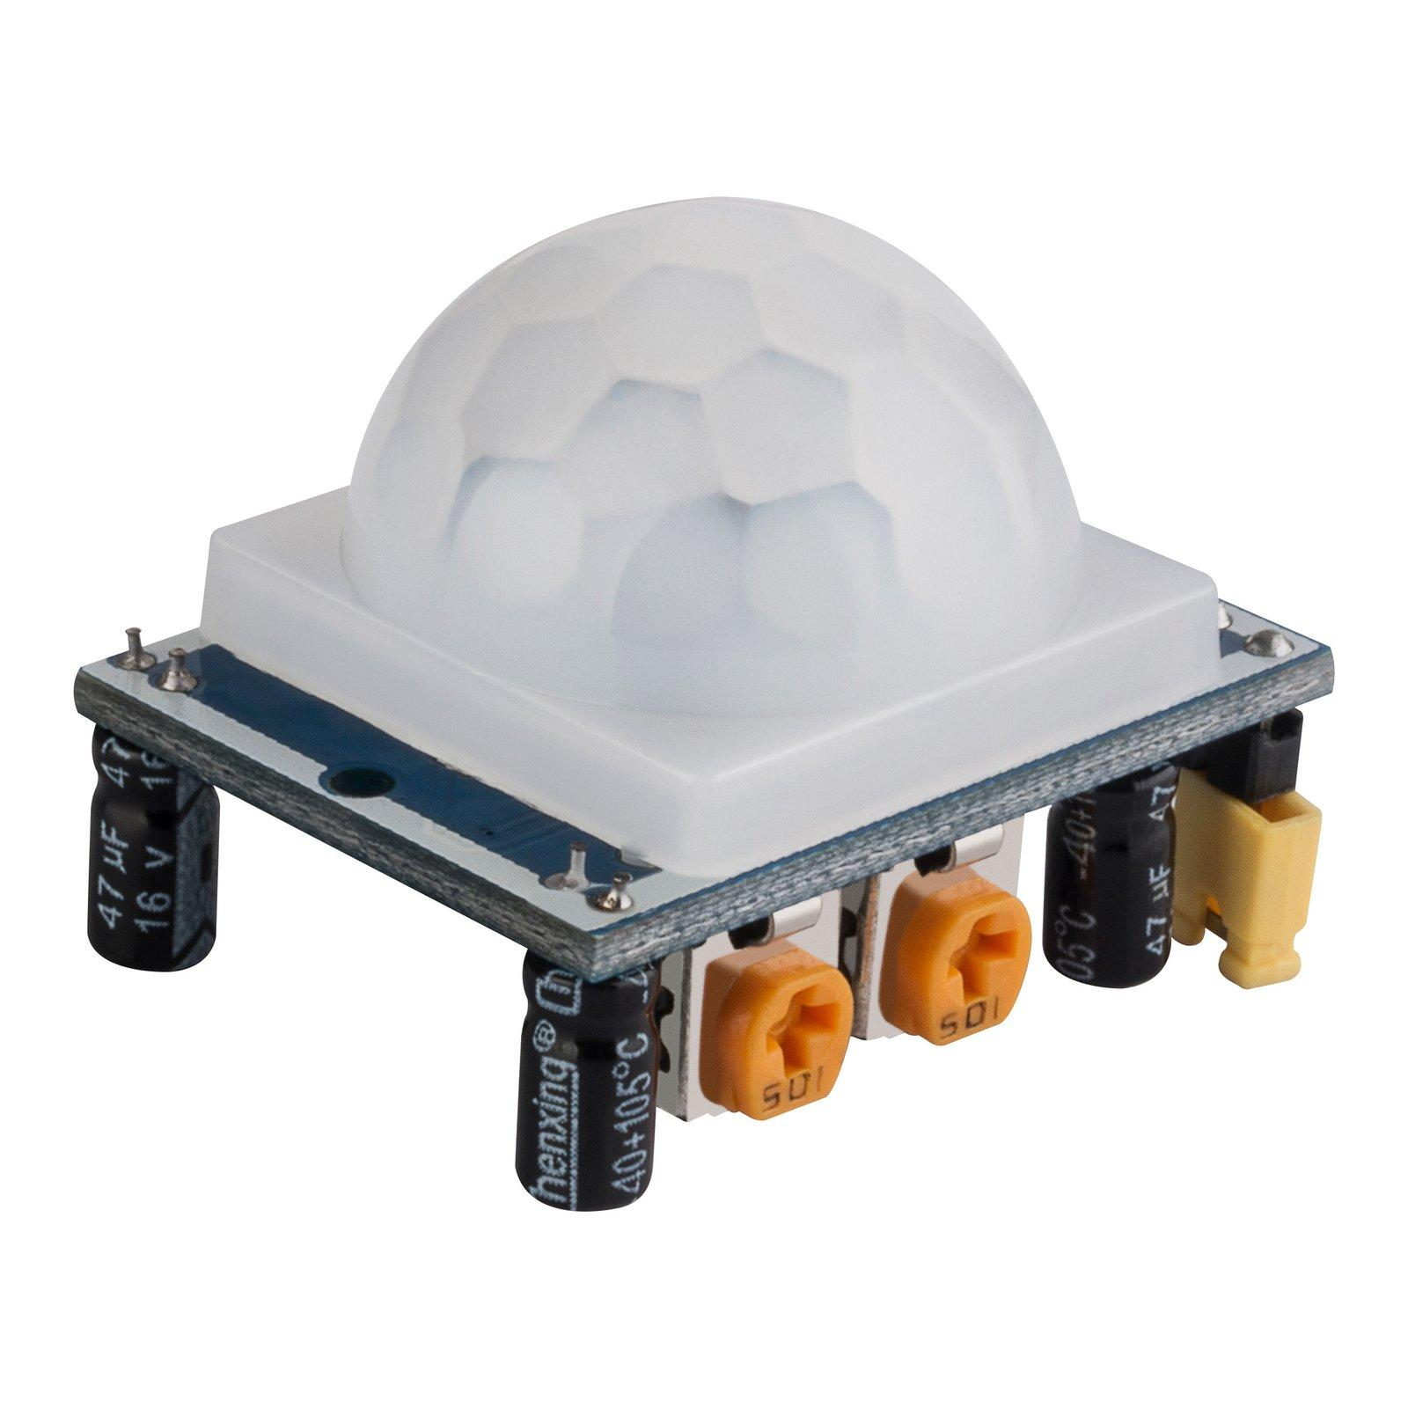
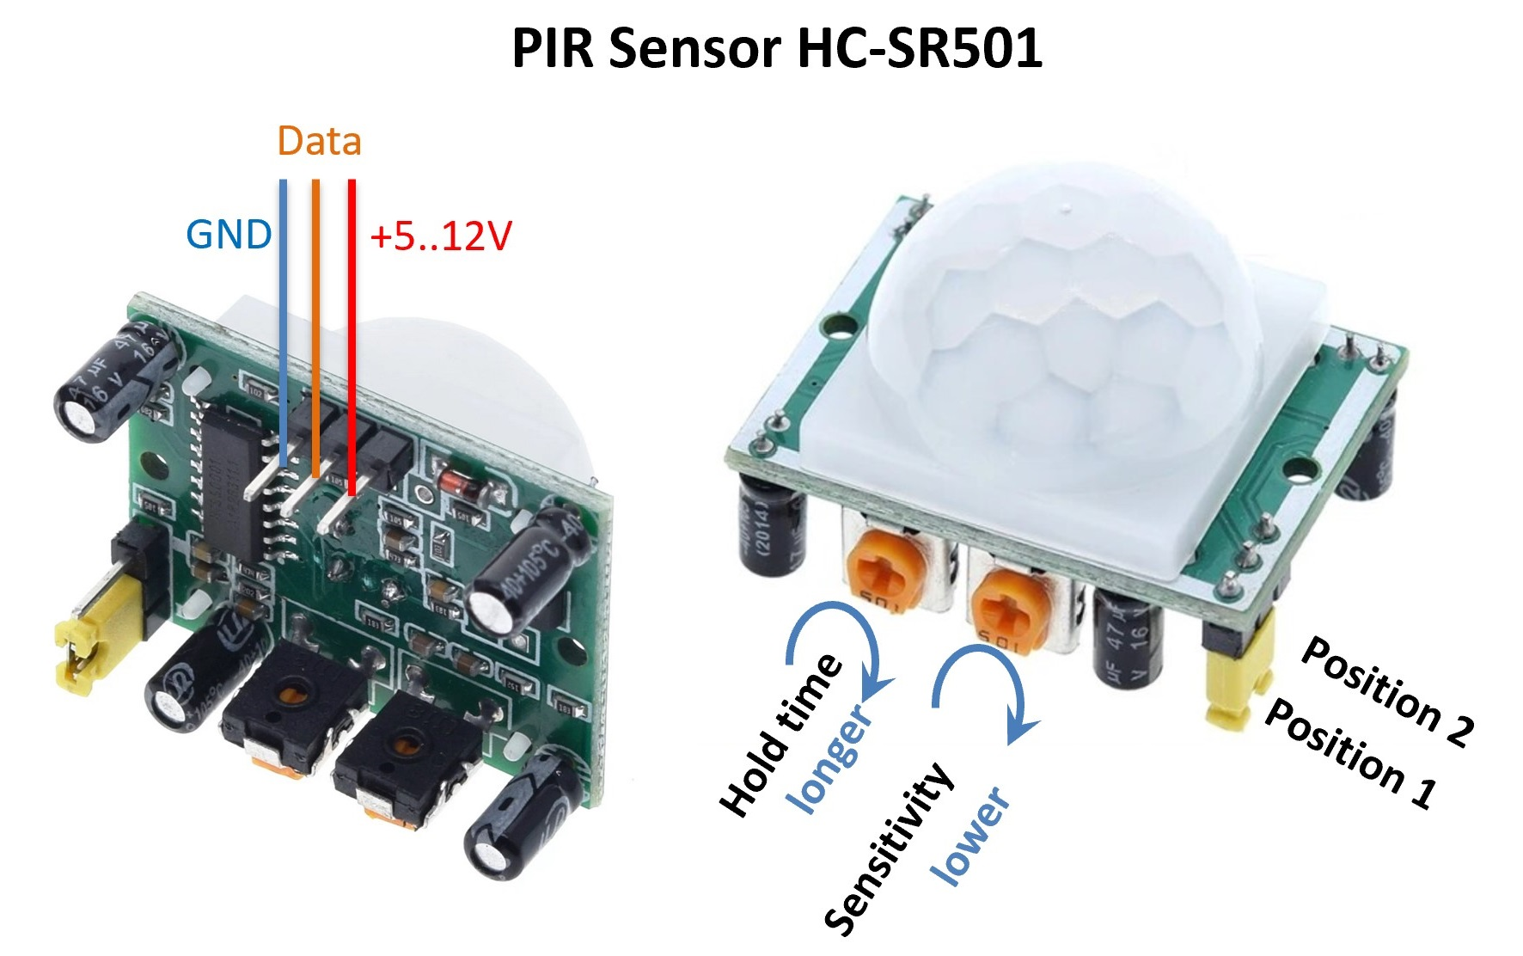
Sensors-PIR Sensor
A passive infrared (PIR) sensor is an electronic device that detects motion by measuring infrared radiation from objects. PIR sensors are used in security systems, lighting, and other applications that require motion detection.

Slide 14
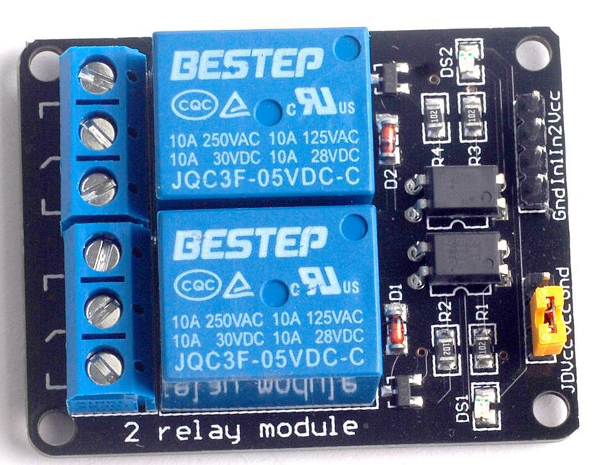
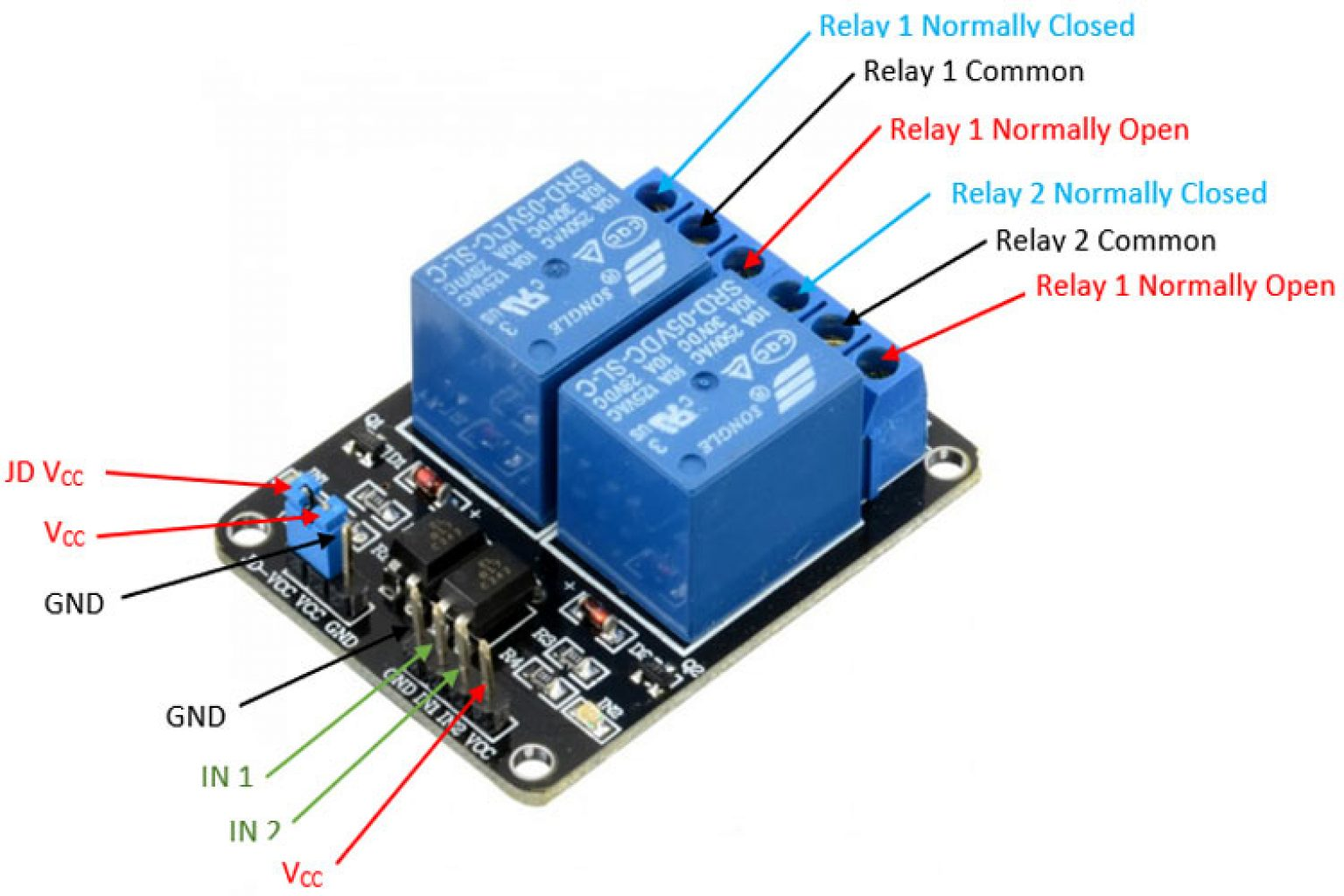
Output device-Double channel Relay
Relay modules serve as interface devices that enable the transfer of signals and information between different devices or systems. They act as a bridge, allowing low-powered digital electronics, such as microcontrollers like Arduino or ESP 32, to control high-powered devices like motors or lighting circuits.
A 5v relay is an automatic switch that is commonly used in an automatic control circuit and to control a high-current using a low-current signal.

Slide 15
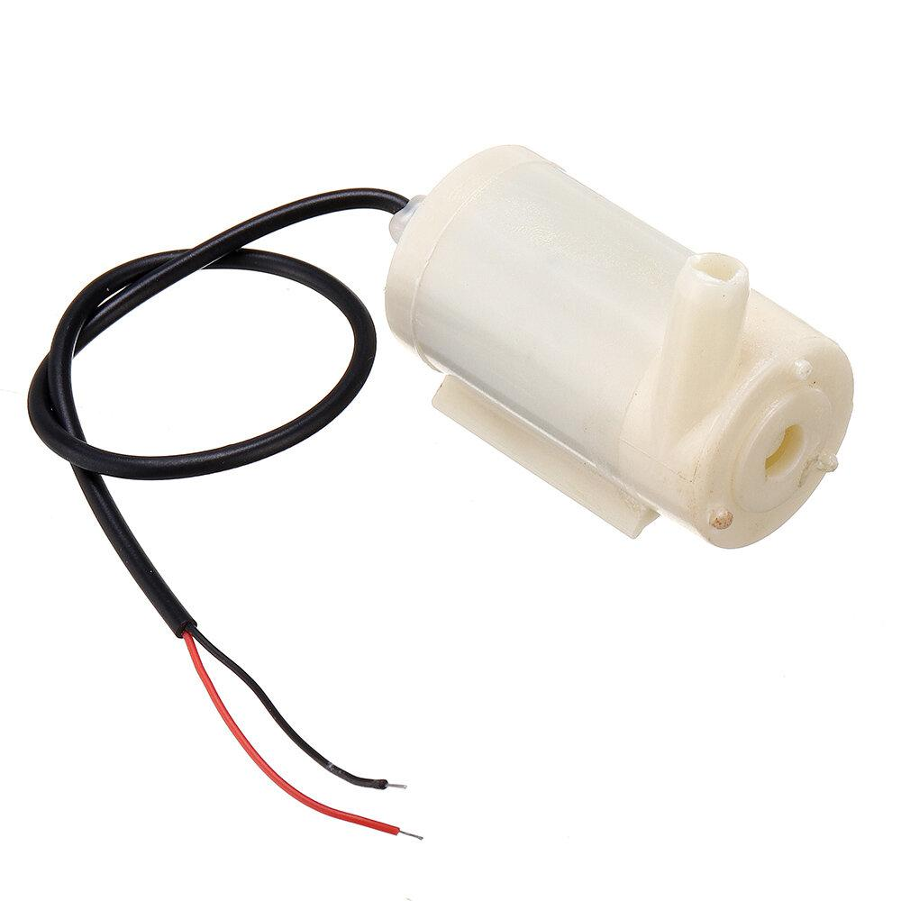
Output device-Pump
The DC Water Pump is a compact and efficient pump designed for use with a 5V direct current (DC) power supply. It is commonly used in applications requiring small-scale water movement or circulation, such as in aquariums, mini fountains, or cooling systems.

Slide 16
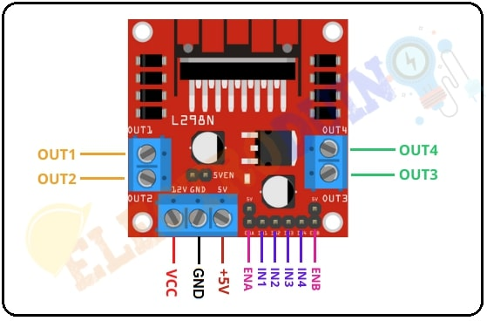
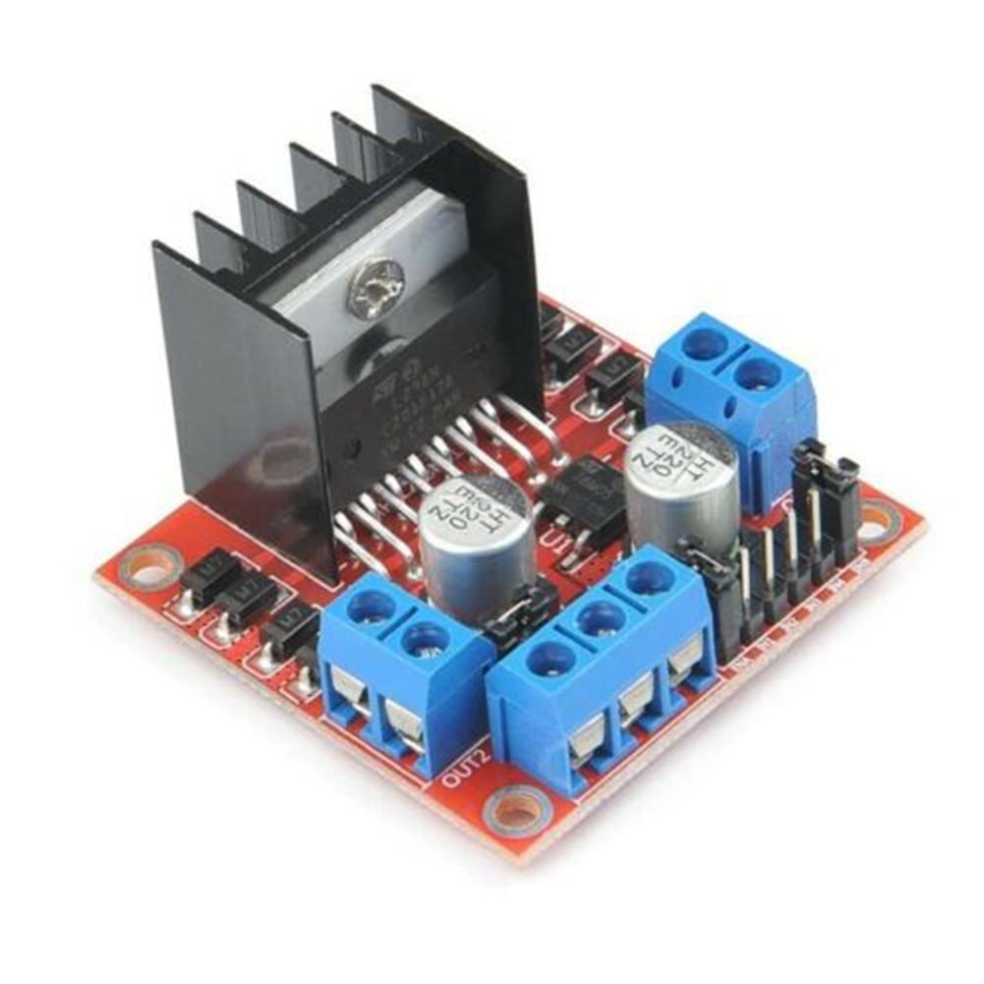
Output device - L298N
The L298N motor driver controls both the speed and direction of rotation of a DC electric motor. It can control up to 4 DC motors, or 2 DC motors with directional and speed control. This motor driver is perfect for robotics and mechatronics projects for controlling motors, switches, relays, etc from microcontrollers

Slide 17
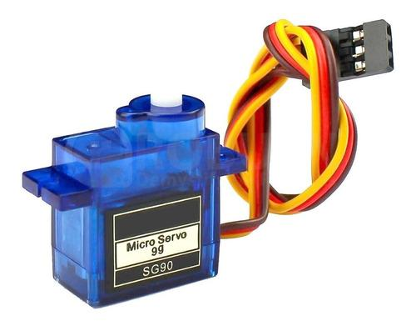
Output device - L298N
A servo motor is an electrical device which can push or rotate an object with great precision. Servo motors have three wires: power, ground, and signal. The power wire is typically red, and should be connected to positive pole (+) of your power source. The ground wire is typically black or brown and should be connected to the negative pole (-) of your power source.

Slide 18

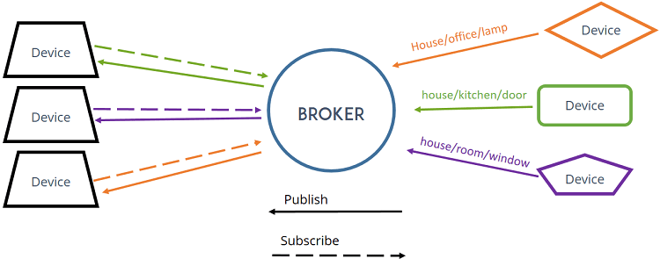
MQTT
MQTT, which stands for Message Queuing Telemetry Transport publish-subscribe messaging protocol, primarily used for connecting devices in IoT and IoT applications, enabling efficient data exchange and communication between devices with minimal bandwidth and power consumption.

Slide 19
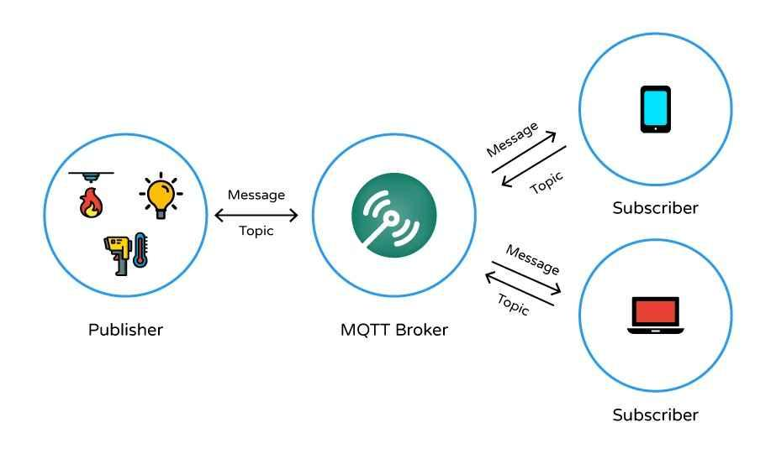
MQTT
An MQTT broker is a server that facilitates communication between MQTT clients by receiving, filtering, and distributing messages based on topics, ensuring efficient and reliable communication in a publish/subscribe messaging system.

Slide 20

Virtuino App
Virtuino is an HMI (Human Machine Interface) platform and Android app used to create visual interfaces for controlling and monitoring IoT (Internet of Things) devices, Arduino, ESP8266, ESP32, MQTT brokers, offering features like Bluetooth, Wi-Fi control.
.

